Slide 1
Homeowners Association Application CSC480A Dec-19: Capstone Project Proposal
Team Members: Brian Hurst, Thomas Lowe, Ravanth Matha, Matthew Parra

Slide 2
CSC480A – Homeowners Association Application
Agenda
Introduction and Background
Project Objectives
Project Scope
Project Stakeholder(s)
Project Requirements
Assumption, Constraints
Issues and Risks
Technology, Tools, Platforms for implementation
High Level Architecture
Product Features
Agile Iteration Plan, Team Responsibilities
Conclusion
References

Slide 3
CSC480A – Homeowners Association Application
Introduction and Background
Homeowners Association application will be a mobile application
Improve communication between homeowners and the Homeowners Association
Expediting the approval process for the desired work
Allows Homeowners Association the ability to track homeowner requests and projects
Board members will be able to communicate new policies to homeowners
Notes:
A key part of Homeowner Associations has been the communication between homeowners and the association’s board of directors. It is important for us to discover the needs of the Homeowners Association before any development can be done. The intent is to understand stakeholders’ objectives for the project and to gather requirements that help define software features and functions. Traditionally homeowners use phone communication and paper forms that need to be submitted for processing by the board of directors. The board members may also need to communicate new policies to the Homeowners Association members, which is typically done through a notification placed in the homeowner’s mailbox or taped to their door. While physical copies of paperwork and notifications can be misplaced, the process for gaining approval for any home augmentation can be arduous. The Homeowners Association application will be a mobile application that allows its users to submit work requests, such as exterior and interior home augmentation, to their Homeowners Associations for approval. This application is expected to expedite the approval process and allow Homeowners and the Homeowners Association board of directors to track requests and provide approval while keeping Homeowners up to date with the latest policies.

Slide 4
CSC480A – Homeowners Association Application
Project Objectives
The main objective of this application is to provide a streamlined ability to submit and view work requests.
To make a request homeowners should provide:
contact information along with unit number
a description of the desired work
Attaching images to their request as needed
Attach a quote from a licensed contractor
Date(s) of intended work
The work requests might include, but are not limited to:
Changes in yard configuration
Replacement of outdoor light fixtures
Repair or replacement of electrical or plumbing components
Reviewed by the board of directors, they can establish pre-approval, approval, or denial
Notes:
The objective of this Homeowners Association application, will be to provide a streamlined ability to submit and view work requests. The work requests submitted by homeowners might include, changes in yard configuration, replacement of outdoor light fixtures, and the repair or replacement of electrical or plumbing components. Work requests can be made by providing homeowner contact information along with unit number and a description of the desired work, attaching images to their request as needed. The work requests submitted will be reviewed by the board of directors for pre-approval and final approval. Upon pre-approval, homeowners must provide contractor information, if necessary, along with contact information and appropriate licenses of said contractor. Homeowners will also need to attach a quote from the contractor, if necessary, and date(s) of intended work. Once the request is approved by the board of directors, the homeowner can set their appointments and begin work. The board of directors will also be provided with a means of viewing requests, communicating with the homeowner, adjusting approval levels, and monitoring the progress.

Slide 5
CSC480A – Homeowners Association Application
Project Scope
The scope of the application within the objective will require users, homeowner or board member, to login to the application to operate any function.
Homeowners:
Create and view new work requests
View the community policies
Provide and receive feedback and documentation about the job performed
Cancel their requests at any time during the process.
Board of Directors:
Provide feedback to homeowners
Maintain a community policies
Approve or deny requests
Notes:
Homeowners and Board members will need to login. Homeowners will be able to not only create new work requests but also view their requests, create or edit their requests and its status, as well as provide and receive feedback and documentation about the job performed. Additionally, the homeowner will be able to cancel their requests at any time during the process. Not only will the Homeowners Association application provide homeowners with a portal for making requests, but the board of directors will also be able to login and review requests, provide feedback to homeowners, maintain policies, and ultimately approve or deny requests.

Slide 6
CSC480A – Homeowners Association Application
Project Stakeholder(s)
For the Homeowners Association application, the stakeholders of the project are:
Homeowners Association board of directors
Homeowners
The team developing the application (Team 2)
Notes:
It is important for this project to identify the customers and stakeholders. A stakeholder is anyone who has a stake in the successful outcome of the project—business managers, end users, software engineers, and support people. The stakeholders of this project are The Homeowners Association board of directors, homeowners, and team developing the application (us). Communication will be maintained with homeowners on issues of concern or type of problems they want to commonly report to the Homeowners Association board of directors. In addition, the homeowners can correspond with us to discuss the best way to serve their needs of communication with the board of directors.

Slide 7
CSC480A – Homeowners Association Application
Project Requirements
Functional Requirements for homeowners and board members:
Login/Logout
Submit/Process work requests
View/Edit request status
View/Edit Homeowners Association Policies
Create/Delete accounts
Non-functional Requirements:
Application Security
Performance
Reliability
Error Handling
Notes:
It is important for us to understand the requirements necessary to provide a working product. Functional requirements are product features or functions that developers must implement to enable users to accomplish their tasks. The following represents the requirements for the user application, which will be utilized by the homeowner. Login/Logout , Submit/Process work requests , View/Edit request status , View/Edit Homeowners Association Policies , Create/Delete accounts . Nonfunctional requirements describe how a system must behave and establish constraints of its functionality. The non-functional requirements of this application are centered around security and reliability.

Slide 8
CSC480A – Homeowners Association Application
Assumptions
Application will be used by homeowners and Homeowners Association board members.
Key members of the project team have a good understanding of what the Homeowners Association application is trying to achieve for its customers.
The team understands their role and works to their skill.
The application will be developed with a ‘Quality’ software concept in mind.
All key players and team members are available for the next two months to collaborate on the development of the application.
The application will be a tool for the Homeowners Association to expedite their processes.
Board members will be able to approve or deny work requests without the application, but still use the application to notify homeowners of status.
Notes:
When considering the design of the Homeowners Association Application, we have compiled a list of assumptions. First, homeowners and board members will be using the mobile application. The project team has a good understanding of what the Homeowners Association application is trying to achieve. Team members understand their roles and works to their skill level. A ‘Quality’ software concept will be kept in mind throughout the process. Stakeholders will be available for the next two months to collaborate on the development of the application. The application will work as a tool to expedite Homeowners Association processes. Finally, Board members will be able to approve or deny work requests without the application, but still use the application for notification to homeowners about the status of their work requests.

Slide 9
CSC480A – Homeowners Association Application
Constraints
Having only four team members to design and develop the project
Time is restricted, with only a limited number of weeks to build a working product.
Developer skill level and platform knowledge differs among team members.
Technology is limited for development.
Customer requirements are limited to our personal knowledge and experiences with Homeowners Associations.
Notes:
No project goes without having some inherent constraints. Looking forward, we can assert certain constraints for our project. First, we only have four team members to complete this project. Additionally, time is significantly restricted. Our team of developers are limited by their current level of experience and skill set. To that, The technology used to develop this application is also limited to our own personal systems. Finally, the customers' requirements are limited to our own personal knowledge and experiences.

Slide 10
CSC480A – Homeowners Association Application
Issues and Risks
Due Date: The given time to properly develop the application features is too short.
Feature Abstraction: There are too many features requested to include in the application
Adoption: The application is too difficult to deploy, ie. database deployment
Hardware limitations: Not all Homeowners and board members have smart phones/data plans to accommodate application use
Understanding: Board members and Homeowners do not understand how to use the application
Management Changes: New members to the board of supervisors who require new features
Performance: The application does not perform as intended, ie. slow or doesn’t produce correct results
Notes:
Taking a proactive strategy will allow us to preemptively alleviate risk. Potential risks are identified here, while their probability and impact are assessed. Each given scenario will be ranked by level of importance and systematically mitigated through considering the projects schedule, support, cost, and performance estimations. Each plan will be carried out by one of us through documentation and project planning. For Due Date, we will Create a thorough time table for each feature and its creation, Feature Abstraction issues will be reduced by reviewing and identifying the key requirements that are necessary to create an application that fills the needs of the Homeowners Association and the Homeowners, We will provide key documents necessary to deploy the application within the Homeowners Association’s abilities, To allow those who do not have an Android smartphone templates with similar forms required to make requests will be provided by the Homeowners Association, If board members change we will provide the new board member or members with documentation that highlights current features. Finally, we will run as many unit tests within our means to prevent any unforeseen issues performance issues.

Slide 11
CSC480A – Homeowners Association Application
Technology, Tools, Platforms for implementation
The end user will be utilizing the application on the Android mobile platform
The android application will make network calls using Retrofit & OKHTTP
Interacting with our API endpoints hosted on Amazon Web Services (AWS for short).
AWS will host our domain utilizing Route 53.
The web service will be connected using AWS Lambda, with a function written in Python
The Lambda function can be automatically connected to AWS API Gateway which can be used to generate endpoints
The Lambda function will connect to an AWS hosted MySQL database

Slide 12
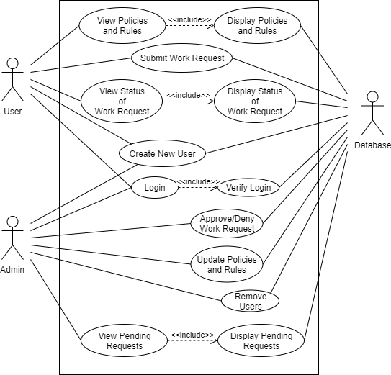
CSC480A – Homeowners Association Application
High Level Architecture
Use case Diagram
Notes:
Name:

Slide 13
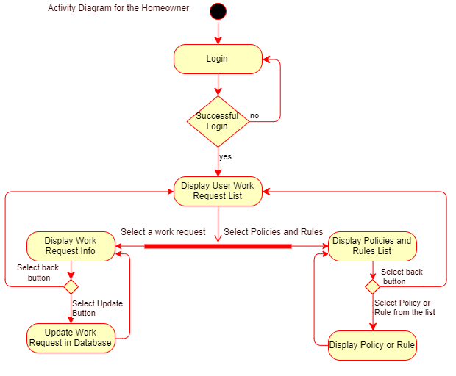
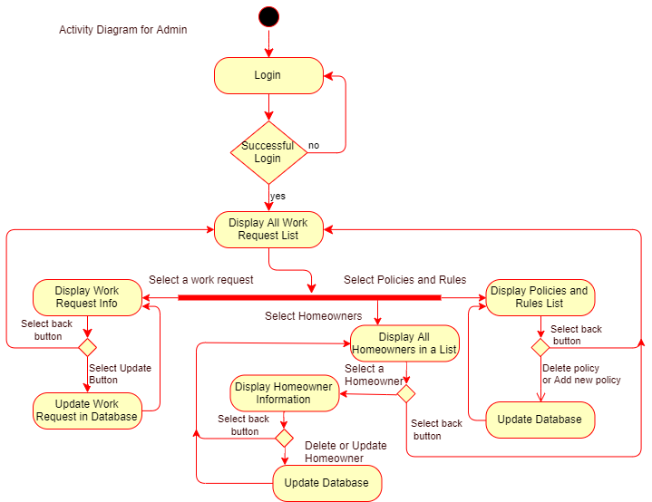
CSC480A – Homeowners Association Application
High Level Architecture
Activity Diagram
Notes:
Name:

Slide 14
CSC480A – Homeowners Association Application
Product Features
Login/Logout
Administrator and User Account Creation
Work Request Creation/Editing
View Homeowners policies
View Request Status
View Pending Requests
Update Work Requests
View/Update Policy and Rules
Notes:
Name:

Slide 15
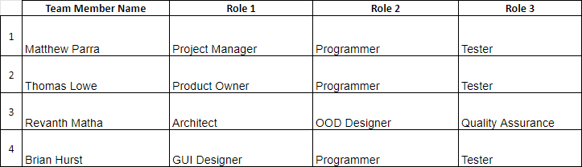
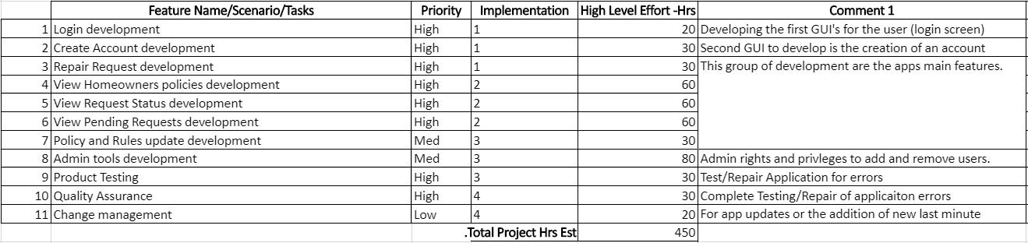
CSC480A – Homeowners Association Application
Agile Iteration Plan, Team Responsibilities
Notes:
During the production of the Homeowners Association application, our team will share responsibilities in order to efficiently complete the project. We have two professional software engineers and one person with an engineering background and another with a mix of software and product owner experience. Revan has the most experienced as he is employed as a mobile application developer. He is a solution architect and is with the entire technology stack. His primary responsibility will be to work on the mobile application and cloud infrastructure as well as system design. I will continue to maintain leadership as Project Manager. With experience in software development using python web services leveraging Django, I can assist Revan in the creation of cloud services necessary to support the application. Thomas continue to represent product owner as well as provide software engineering support. He will be responsible for translating his vision into a design through attainable goals that reflect business value. While Brian’s experience is limited he will supply the team with knowledge about the graphic design and system model. Brian will assist with the Android platform development and will spend the majority of his time on developing the database. We will all share in the responsibility of testing and assuring the application is distributed with no errors.
For the Iteration Plan, tracking each iteration of the project will be important to completing the project and delivering a working product at the expected delivery date. The proposed Homeowners Association application requires us to break the application into multiple iterations, prioritizing, and assessing their expected implementation. Each feature is given a priority level and is estimated to be completed within four iterations starting with the development of the login system, account creation and requests. Our next iteration will be for developing the ability to view homeowner policies, request status. In the third iteration, we will be developing the ability to update policies, administration tools, and begin Quality Assurance which will extend into the fourth iteration where we will be addressing any management changes among the Homeowners Association.

Slide 16
CSC480A – Homeowners Association Application
Conclusion
A mobile application that provides Homeowners the ability to create and maintain work requests
Homeowners can keep apprised of new Association policies
The Board of Directors can maintain Association policies
The Board of Directors can provide feedback to homeowners about requested work
The Board of Directors can establish approval or denial to homeowners requests
Android mobile platform, supported through Amazon Web Services
Completed within approximately eight weeks
Notes:
In conclusion, we propose a mobile application that provides Homeowners the ability to create and maintain work requests for their Homeowners Association Board of Directors to review while being able to keep apprised of new Association policies. Additionally we offer the Board of Directors the capacity to maintain Association policies, provide feedback to homeowners about requested work, and establish approval or denial to homeowners requests. This proposal will be carried out using the Android mobile platform and supported through Amazon Web Services. The application will take approximately eight weeks to complete harnessing each team members unique skill set and experience.

Slide 17
CSC480A – Homeowners Association Application
References
Pressman, R. S., & Maxim, B. R. (2015). Software engineering: a practitioner's approach. New York: McGraw-Hill Education.
Falk, T., & Falk, T. (2019, November 20). Renovations with an HOA: How to get approval. Retrieved from https://www.finder.com/what-you-need-to-know-about-hoa-approval-for-renovations

